Slide 1

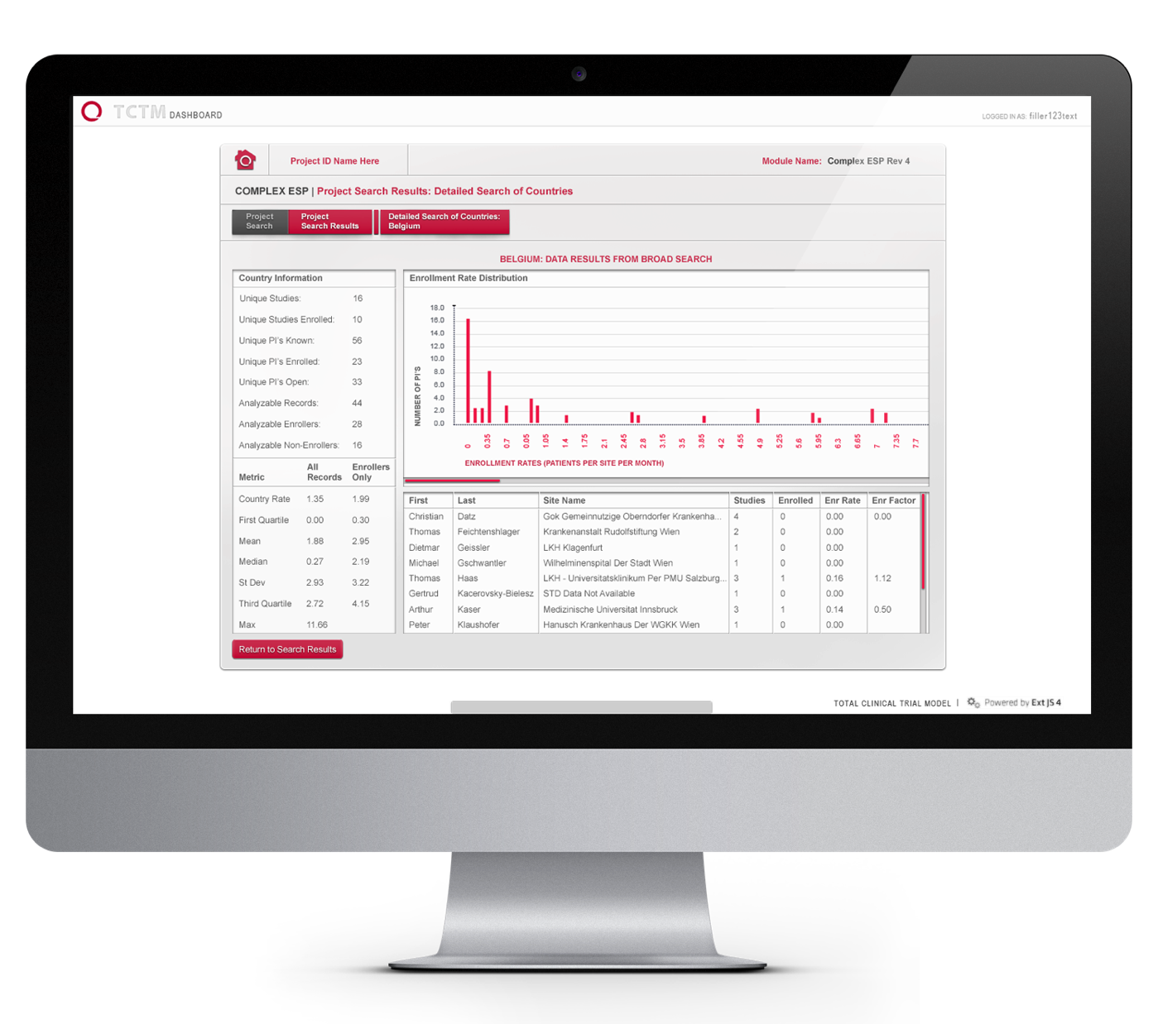
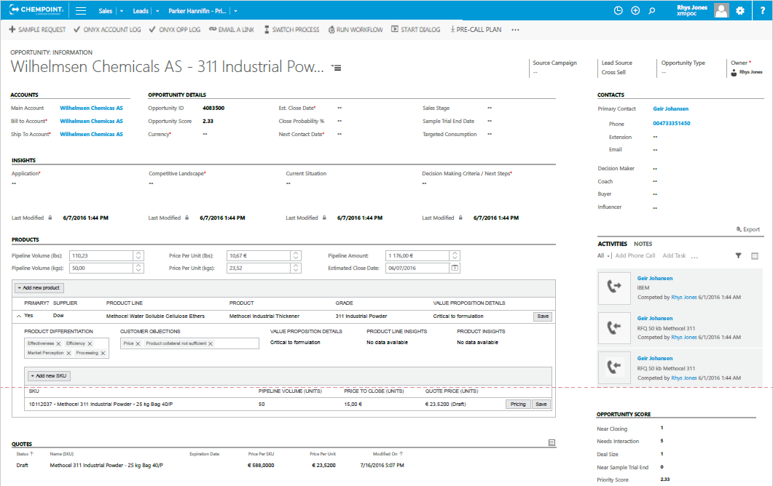
ChemPoint – CRM Redesign & Sales Management Analytics
Business Need
ChemPoint is a chemical sales, marketing and distribution company. They came to Affirma looking for support in redesigning their entire business process for CRM across sales, pipeline management, and quoting. ChemPoint had goals to drastically improve efficiency and CRM user adoption for their sales organization.
What We Did
Affirma met with a large group of ChemPoint stakeholders across various teams including Sales, Management, Product Management, Operations, and IT. Our team identified inconsistencies and gaps in their business processes and built a roadmap to improve them.
Affirma produced comprehensive recommendations to standardize core processes, improve organizational communication, and streamline the supporting technology including CRM and Business Intelligence tools.
Our recommendations also included extensive communication planning and change management support.
ChemPoint has rolled out Affirma’s recommended business process and technical modifications to their CRM and BI platforms. They’ve experienced streamlined communications, increased user adoption, and operational efficiency.

Slide 2

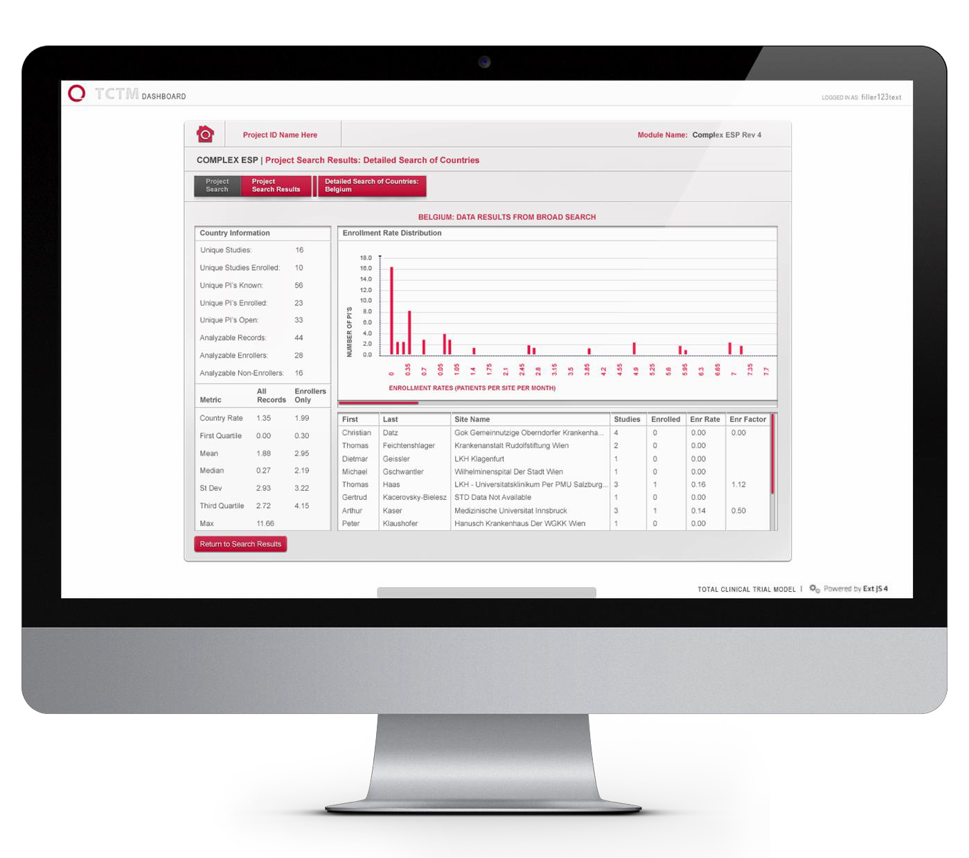
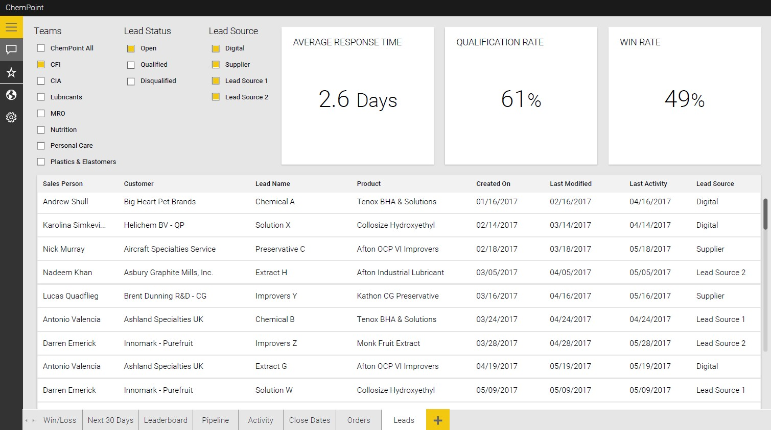
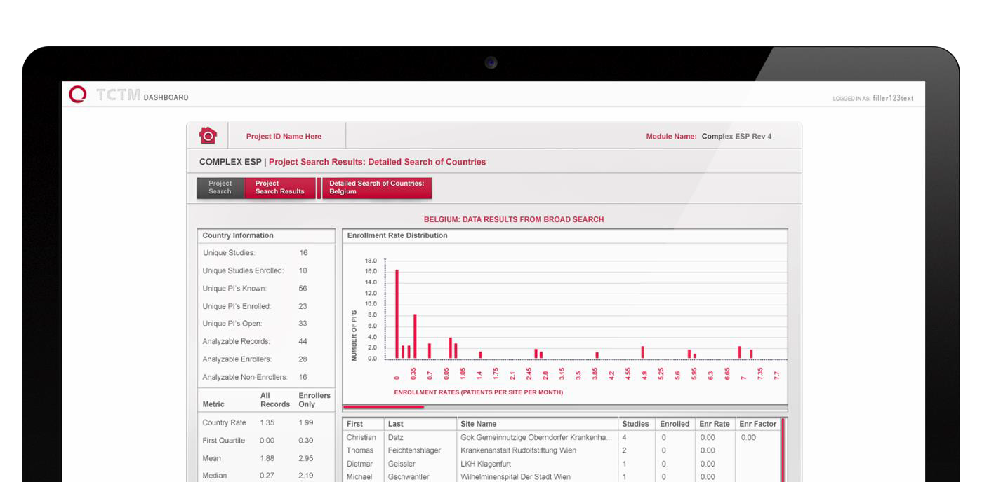
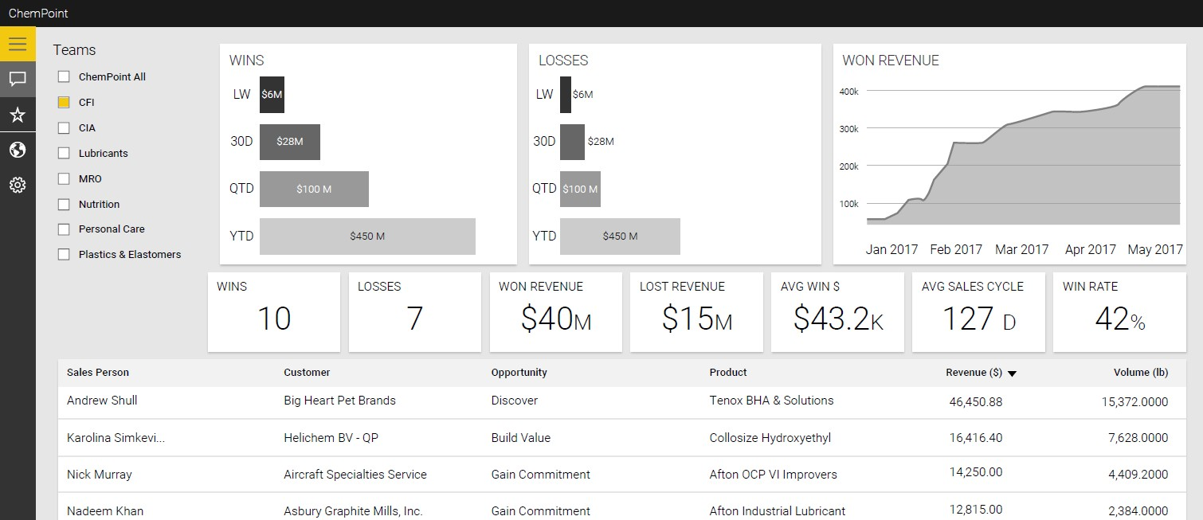

ChemPoint – CRM Redesign & Sales Management Analytics

